Slide 1
Finding Similar items at Scale on Semantic Vectors using Locality Sensitive Hashing
Rohit Bharti
Mentor: Prakhyat Shankesi, Ram Gandhi
Manager: Sunil Shah
Internship Start Date: May 23, 2022

Slide 2
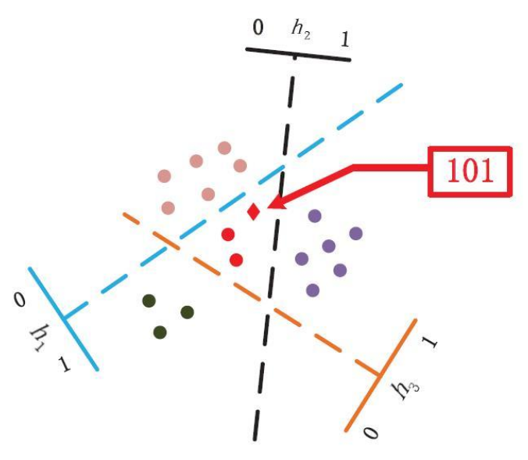
Problem statement: Given a large number (N in the millions or billions)of semantic vector embeddings, Generate candidate sets containing similar items.

Slide 3
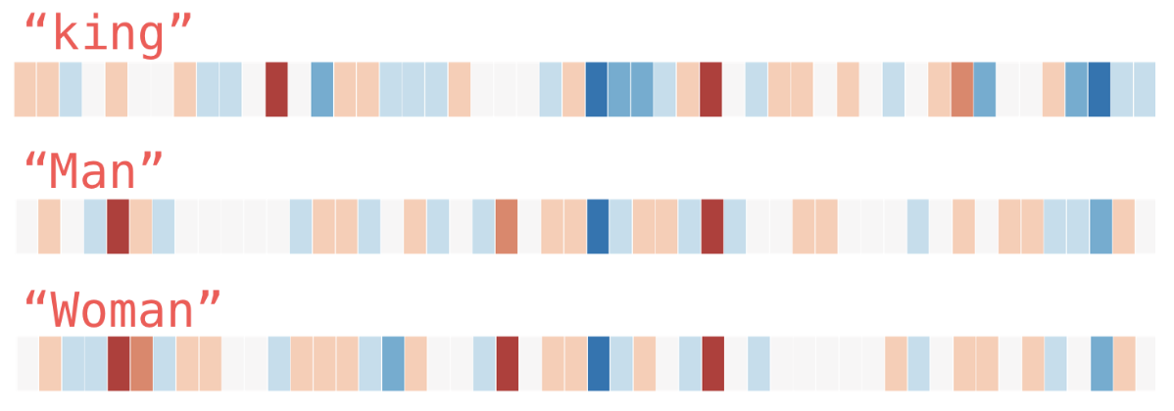
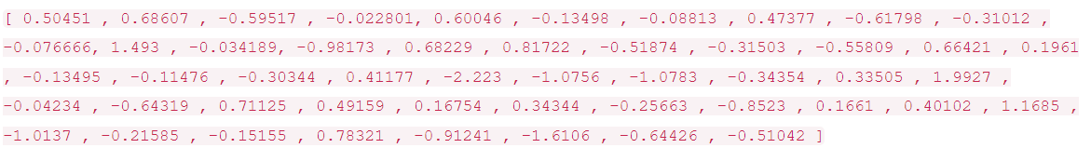
Semantic vector embeddings
Embeddings are dense numerical representations of real-world objects and relationships, expressed as a vector.
Embedding vectors that are close to each other are considered similar.
word embedding for the word “king”
Reference: <https://jalammar.github.io/illustrated-word2vec/>

Slide 4
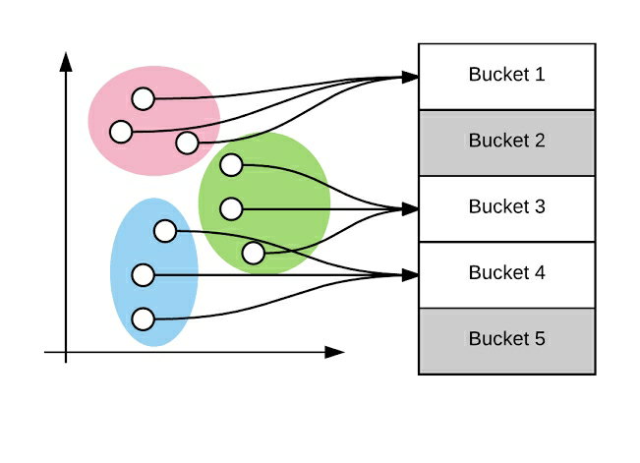
Locality Sensitive Hashing
“Locality-Sensitive Hashing (LSH) is an algorithmic approach to clustering similar input semantic vectors into the same buckets.”
Advantages:
LSH is a faster(O(N)) solution and does not compare all pairs of items.
LSH is one of the most efficient approaches and scalable techniques.
LSH reduces the dimensionality of high-dimensional data.
Reference: <https://www.educative.io/answers/what-is-locality-sensitive-hashing-lsh>

Slide 5
Steps to generate clusters using Locality Sensitive Hashing

Slide 6
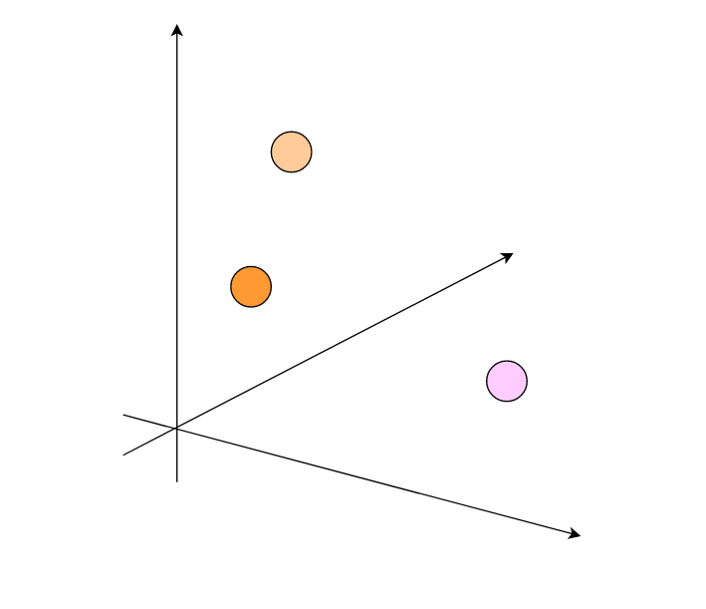
Random Projection
Random projection is a technique for representing high-dimensional data in low-dimensional feature space.
Input data points

Slide 7
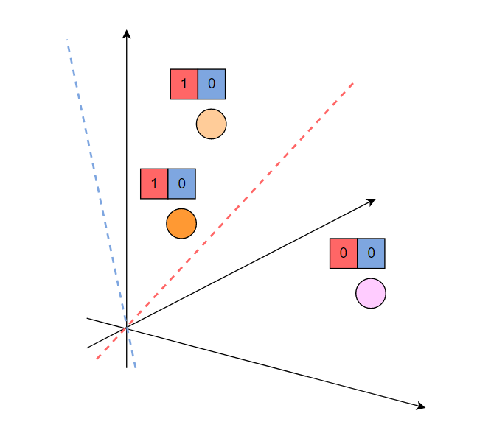
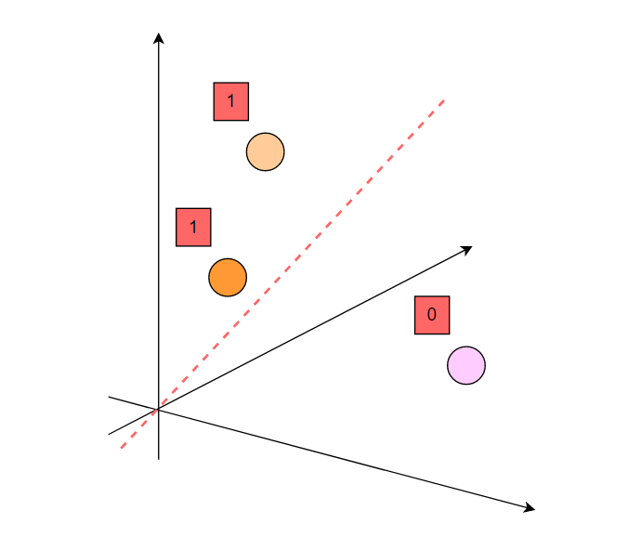
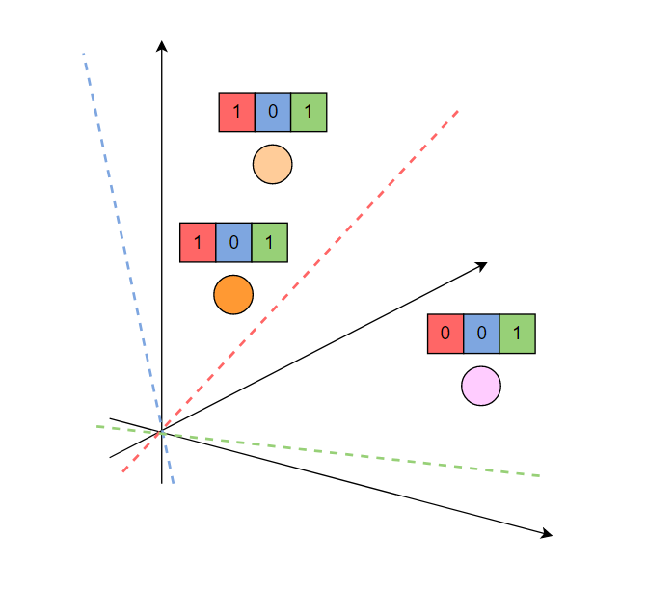
Calculate Signatures
Assigning bit values based on the first hyperplane
Assigning bit values based on the second hyperplane
Assigning bit values based on the third hyperplane
Signature

Slide 8
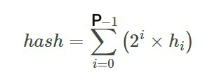

LSH using Random Projection Method
Input Vectors
Random Vectors
Random Vector-1 dot semantic vector
Random Vector-2 dot semantic vector
' '
' '
' '
Random Vector-P dot semantic vector
P = Number of hyper planes
Signature Matrix
Hash Value
p = Number of hyper planes
1*2^0+0*2^1+1*2^2 = 5
0*2^0+0*2^1+1*2^2 = 4
Clusters

Slide 9
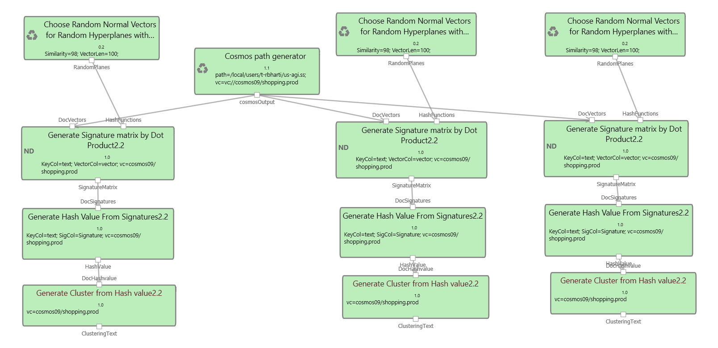
3 Parallel Iterations for finding LSH Clusters
Reference: c37424f9-8a91-4d57-877d-eeb3f7eb9925

Slide 10
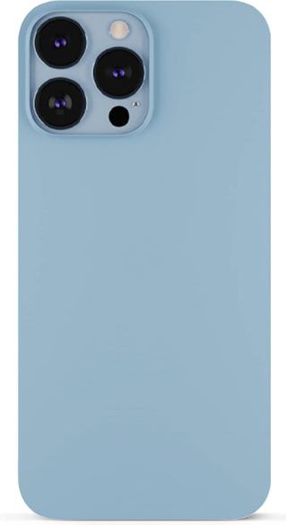
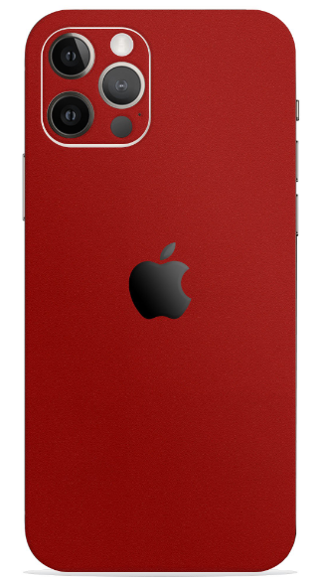

1. Two-Stage Clustering Approach
LSH Clustering addresses the Recall Problem, We can tune the Recall by adjusting the number of hyperplanes.
However, The Similarity of Items is Subjective to the downstream task. Hence, we also need a filtering mechanism to tune the precision.
4GB/64GB
6GB/128GB
Are they similar?
Are they similar?

Slide 11
2. Two-Stage Clustering Approach
Stage 1 (LSH Clustering)
Stage 2 (Hierarchical Clustering)

Slide 12
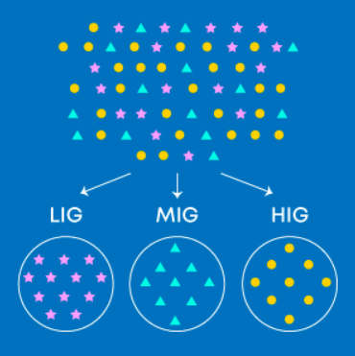
Stage 1- Retrieval (LSH)
Computationally cheap: O(N).
Solves Recall Problem (Removes False Negatives).
Hyper parameter : Number of Hyperplanes.

Slide 13
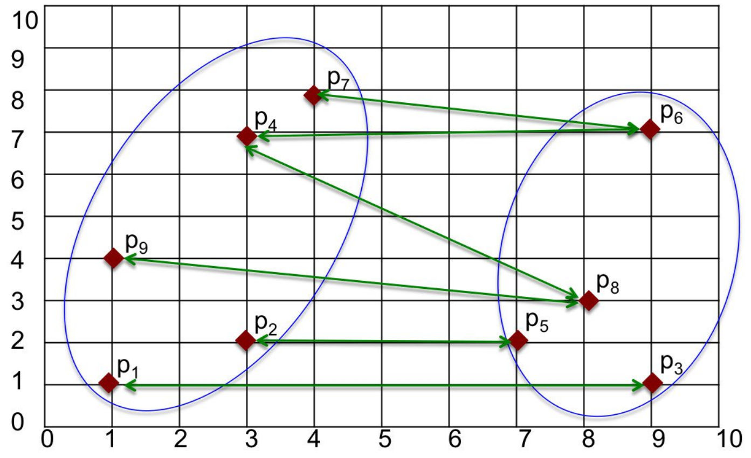
Stage 2- Filtering(Hierarchical clustering)
Computationally expensive: O(N^2).
Solves Precision problem (Removes False Positives).
Hyper parameter: Cosine distance (1- Cosine similarity).

Slide 14
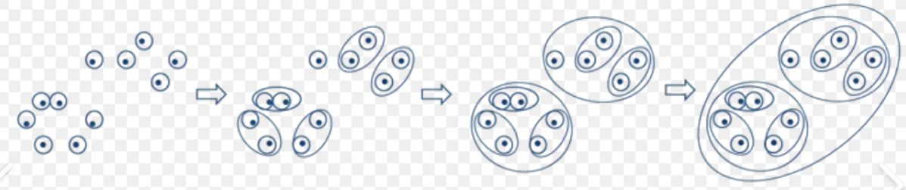
Process of hierarchical clustering

Slide 15
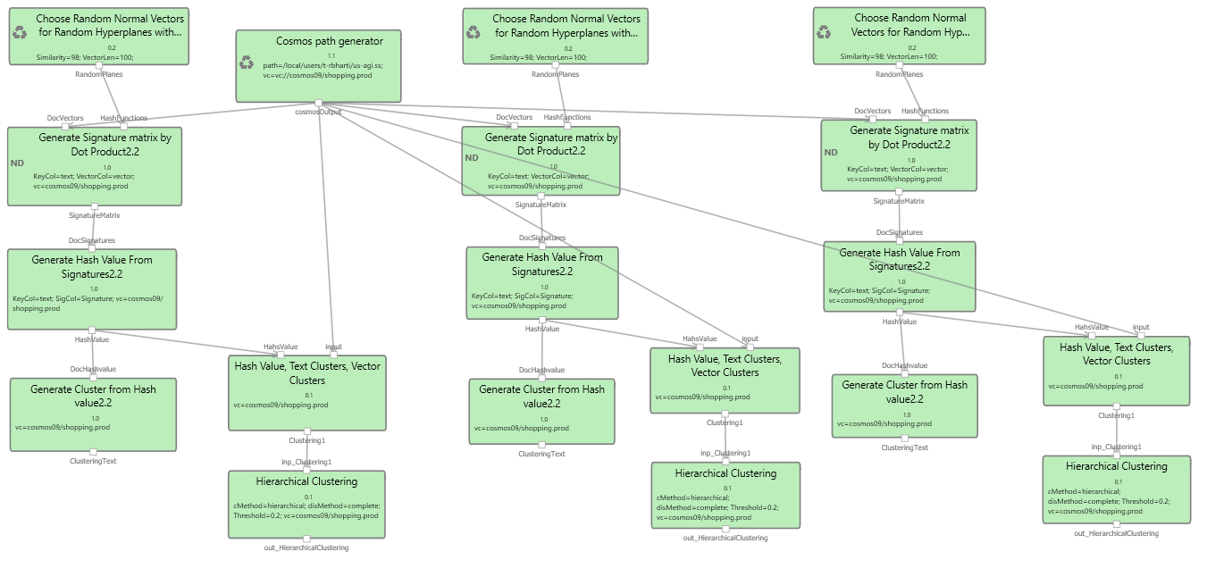
End-to-End Pipeline with Hierarchical Clustering
Reference: 0d86de85-246d-4508-8cbf-5117d2168f6c

Slide 16
Conflation of Offer Corpus containing 1.4 Billion Items

Slide 17
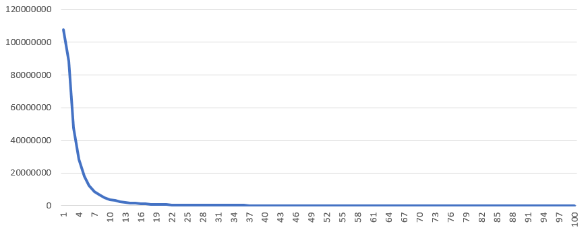
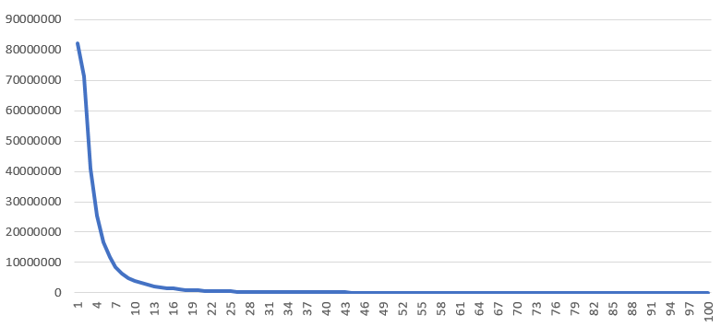
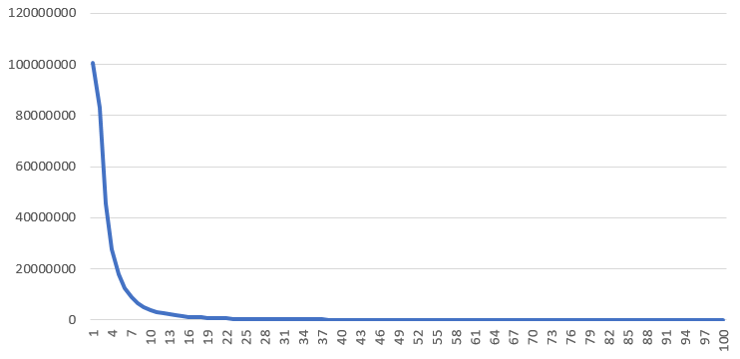
LSH + Hierarchical Clustering on offer embeddings
X- clusters size
Y- Number of clusters
Iteration-1
Average number of Items per Cluster= 4.237
Number of Offers: 1.4 Billion
Number of Hyperplanes: 16
Threshold (Cosine distance): 0.22 (Cosine similarity = 0.78)
Approximation Time of Aether pipeline: 5 Hours
Maximum average number of Items per Cluster: 4.9652
Iteration-2
Average number of Items per Cluster= 4.9652
Iteration-3
Average number of Items per Cluster= 4.4074

Slide 18
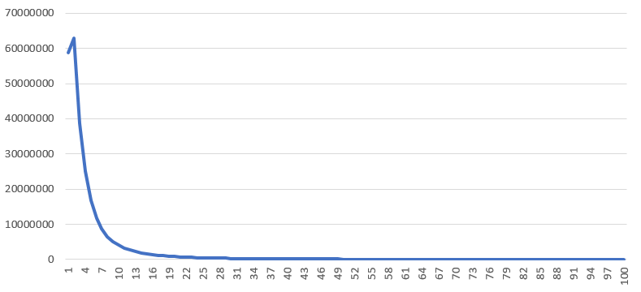
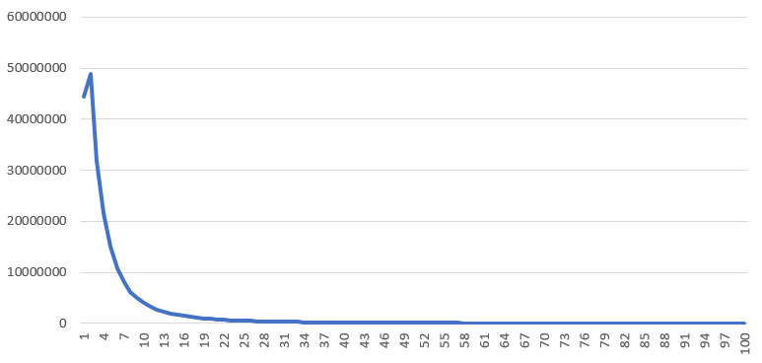
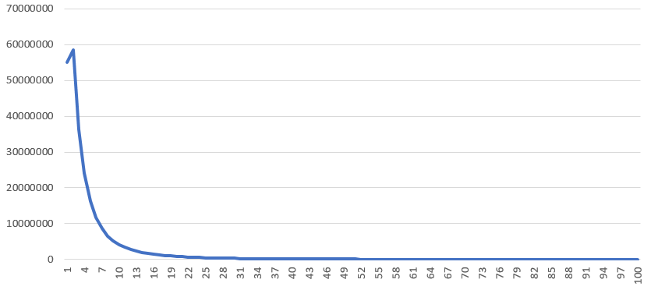
LSH + Hierarchical Clustering on offer embeddings
X- clusters size
Y- Number of clusters
Iteration-1
Average number of Items per Cluster= 5.5748
Number of Offers: 1.4 Billion
Number of Hyperplanes: 16
Threshold (Cosine distance): 0.25 (Cosine similarity= 0.75)
Approximation Time of Aether pipeline: 5 Hours
Maximum average number of Items per Cluster: 6.5843
Iteration-2
Average number of Items per Cluster= 6.5843
Iteration-3
Average number of Items per Cluster= 5.8108

Slide 19
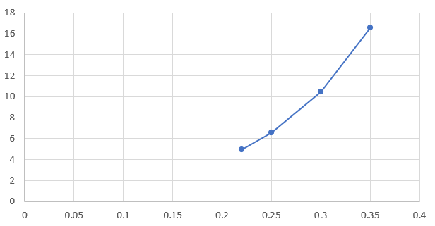
X- Cosine threshold
Y- Average items per cluster
Hyperplanes | Threshold | Average items per cluster
16 | 0.22 | 4.9652
16 | 0.25 | 6.5843
16 | 0.3 | 10.49
16 | 0.35 | 16.597

Slide 20






Examples
Hash value Clusters
100522162 84158880477, 88935975942, 73854734676
Reference: http://productgraph.northamerica.corp.microsoft.com:58889/#/productads/offer/status?filter1=70442901280&filter2=&tier=AMER&queryKey=OfferId&top=10

Slide 21
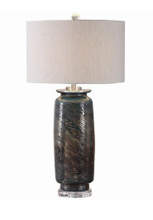
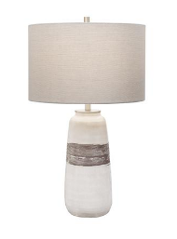
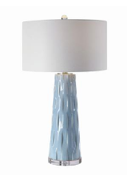



Examples
Cluster = 86286568557, 84836725688, 86286612770
Reference: http://productgraph.northamerica.corp.microsoft.com:58889/#/productads/offer/status?filter1=84836725688&filter2=&tier=AMER&queryKey=GlobalOfferId&top=10

Slide 22
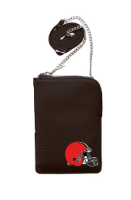








Examples
Cluster = 83328007709;75740157467
Cluster = 90784468694;90365241050
Reference: http://productgraph.northamerica.corp.microsoft.com:58889/#/productads/offer/status?filter1=83328007709&filter2=&tier=AMER&queryKey=GlobalOfferId&top=10
Reference: http://productgraph.northamerica.corp.microsoft.com:58889/#/productads/offer/status?filter1=90784468694&filter2=&tier=AMER&queryKey=GlobalOfferId&top=10

Slide 23
InProgress: Random Projection- Hyper Planes
P = 1-(1-s^r)^b
P= Probability that two items are fall in same bucket
b= Number of iterations
r = Number of hyperplanes
s = percentage of Similarity
b=3 and P=99%
b=3 and P=95%
b=5 and P=95%
s | r
0.8 | 1
0.9 | 2
0.95 | 5
0.96 | 6
0.98 | 12
0.99 | 24
s | r
0.8 | 2
0.9 | 4
0.95 | 9
0.97 | 15
0.98 | 23
0.99 | 46
s | r
0.8 | 2
0.9 | 4
0.95 | 9
0.97 | 15
0.98 | 23
0.99 | 46
Reference: <Locality Sensitive Hashing: How to Find Similar Items in a Large Set, with Precision | by Jonathan Kernes | Towards Data Science>

Slide 24
Thank you

